Slide 1


Slide 2
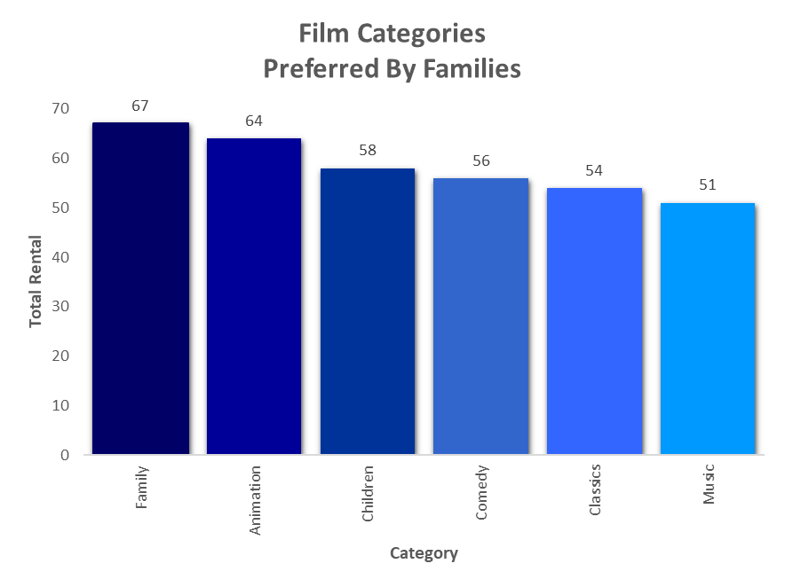
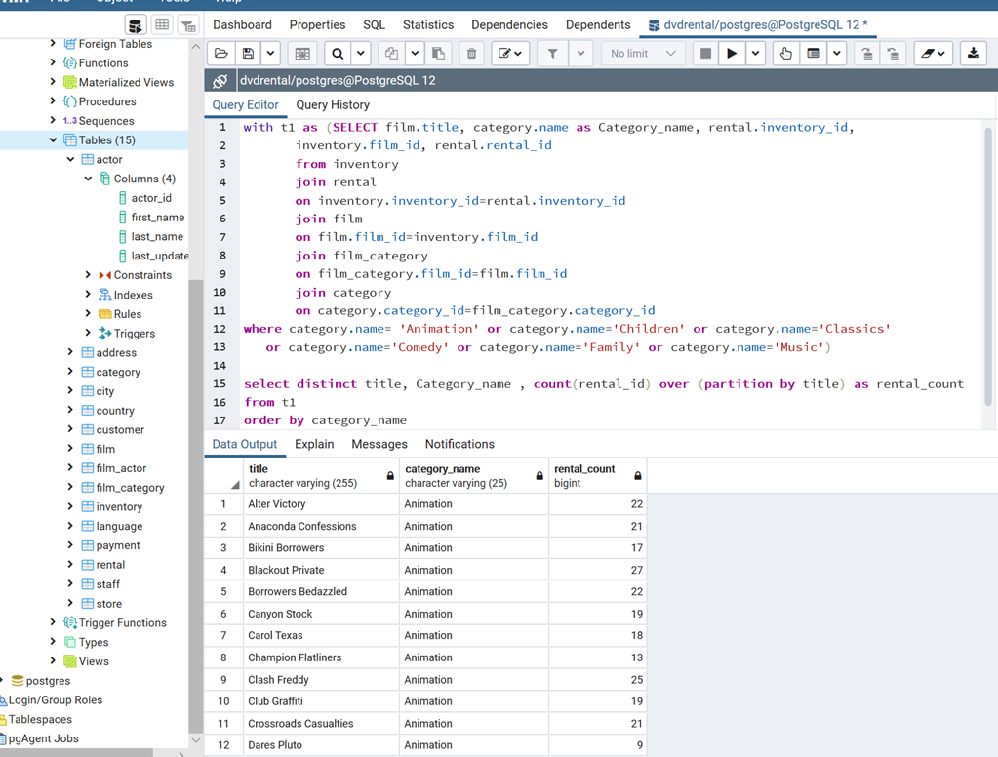
Question 1: To understand more about the movies that families are watching, create a query that lists each movie, film category, and the number of times it has been rented out

Slide 3
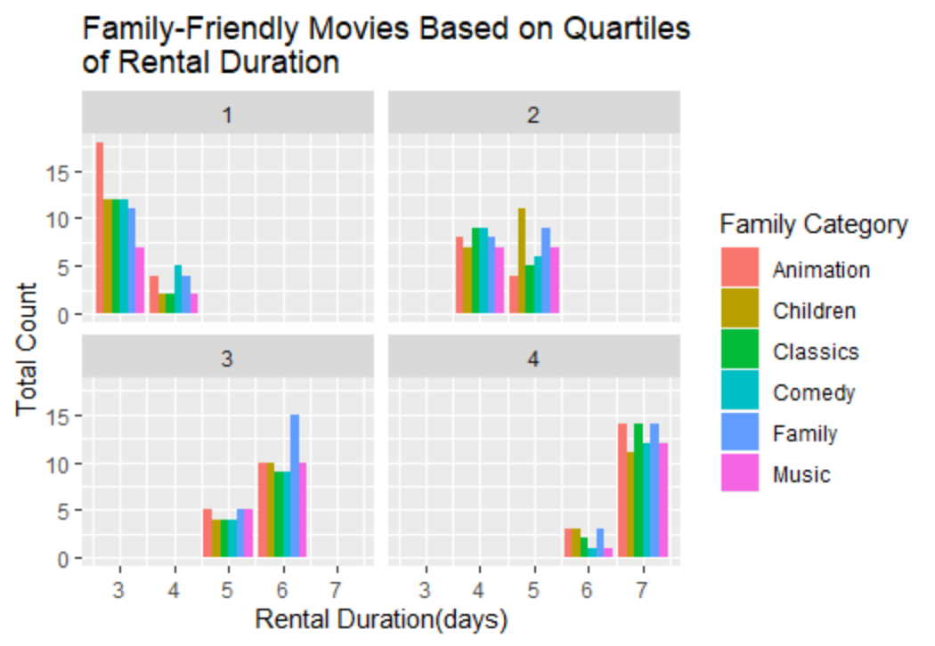
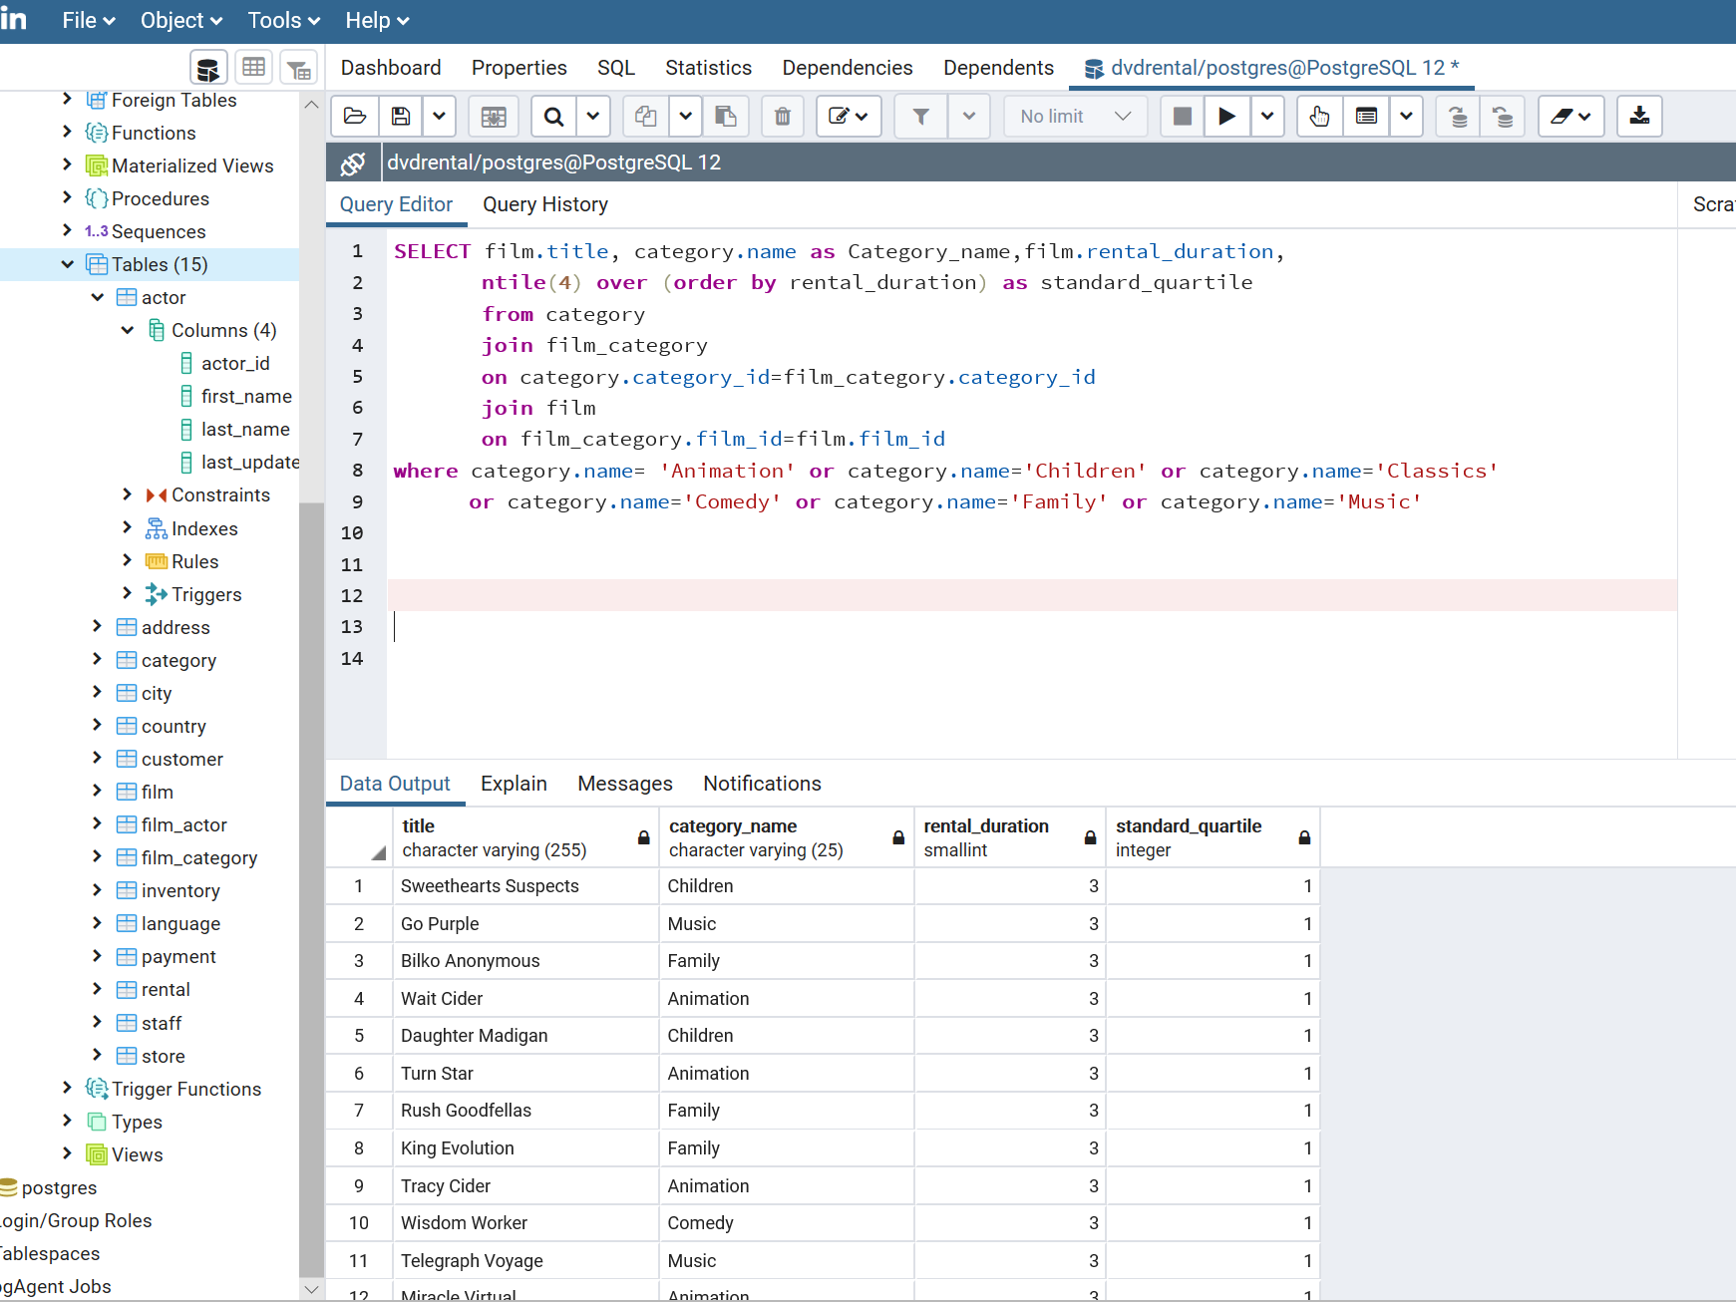
Question 2: Compare the length of the rental duration of family friendly movies to the duration that all movies are rented for. Provide a table with the movie titles and divide them into 4 levels based on quartiles 25%, 50% and 75% of the rental duration for movies across all categories

Slide 4
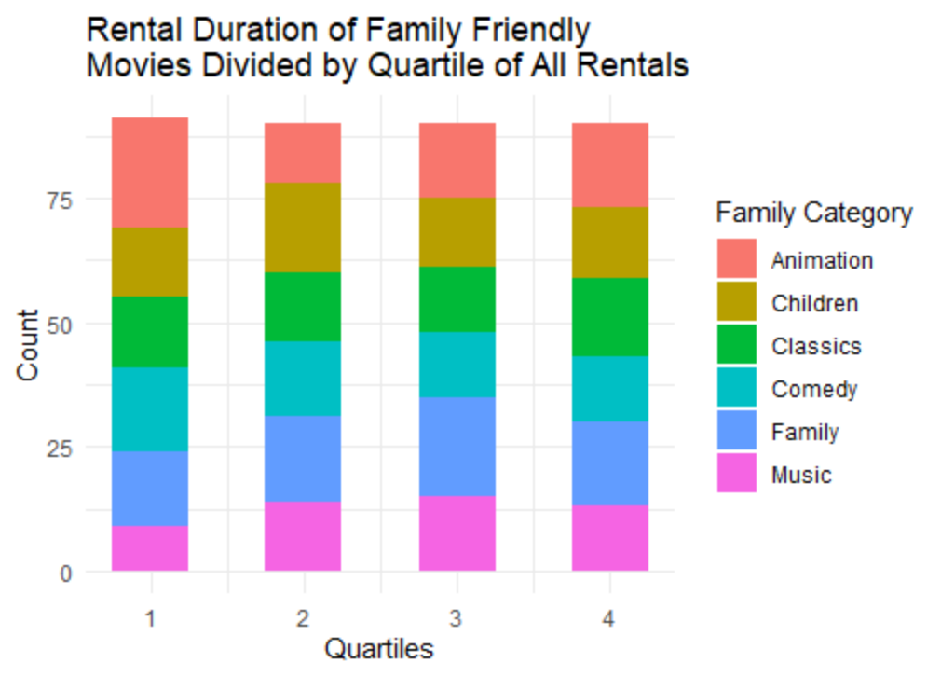
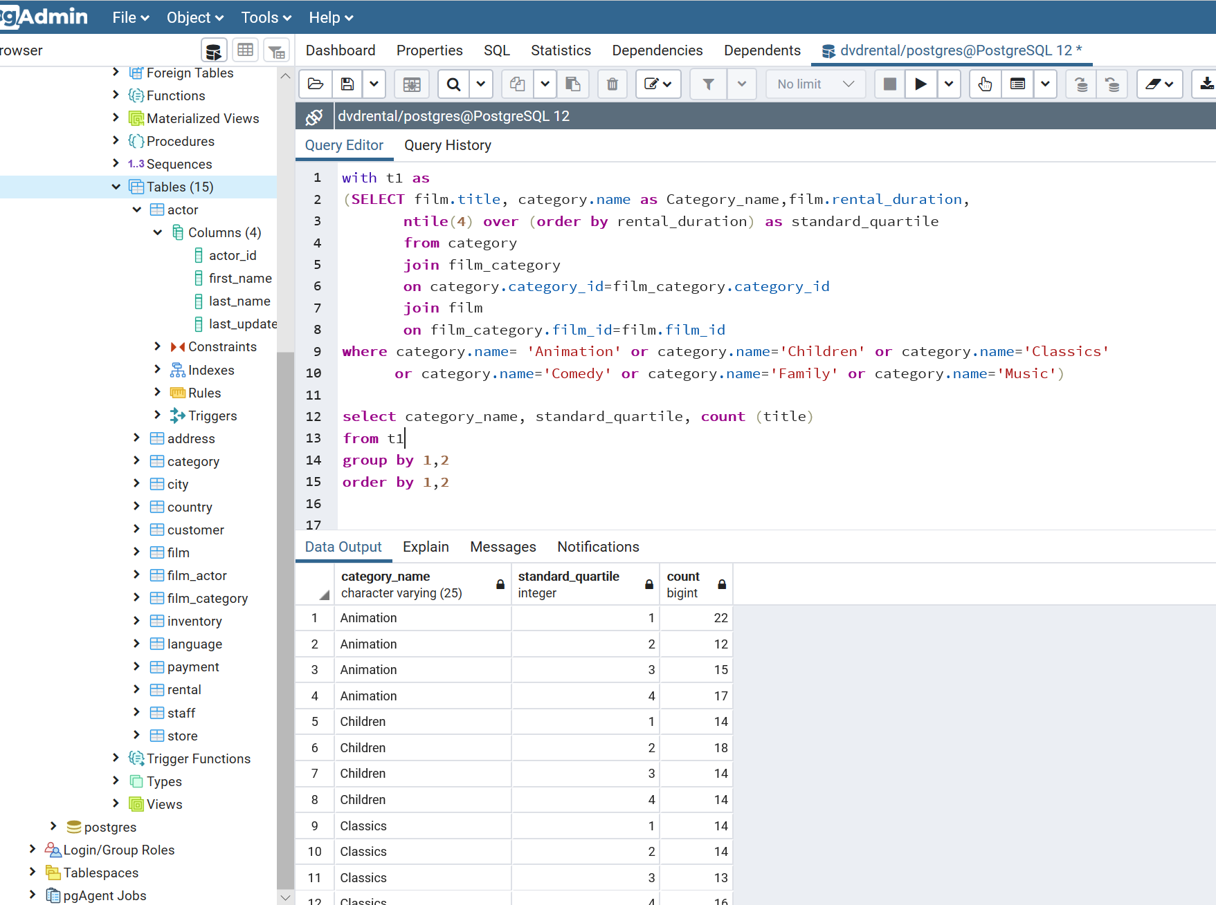
Question 3: Provide a table with the family-friendly film category, each of the quartiles, and the corresponding count of movies within each combination of film category for each corresponding rental duration category

Slide 5
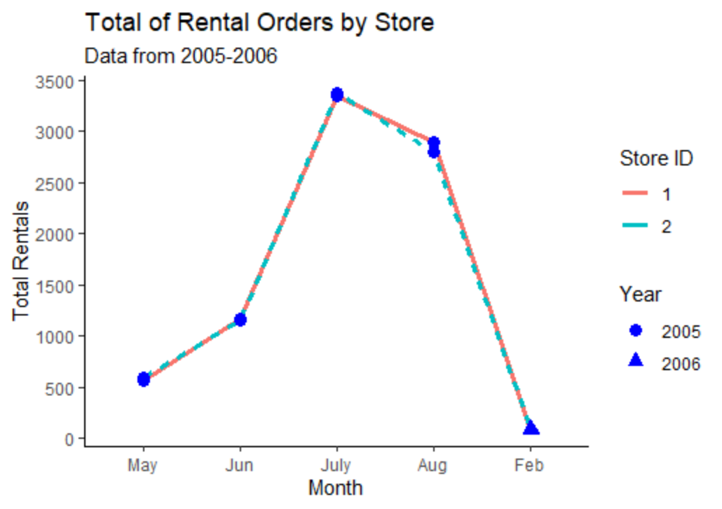
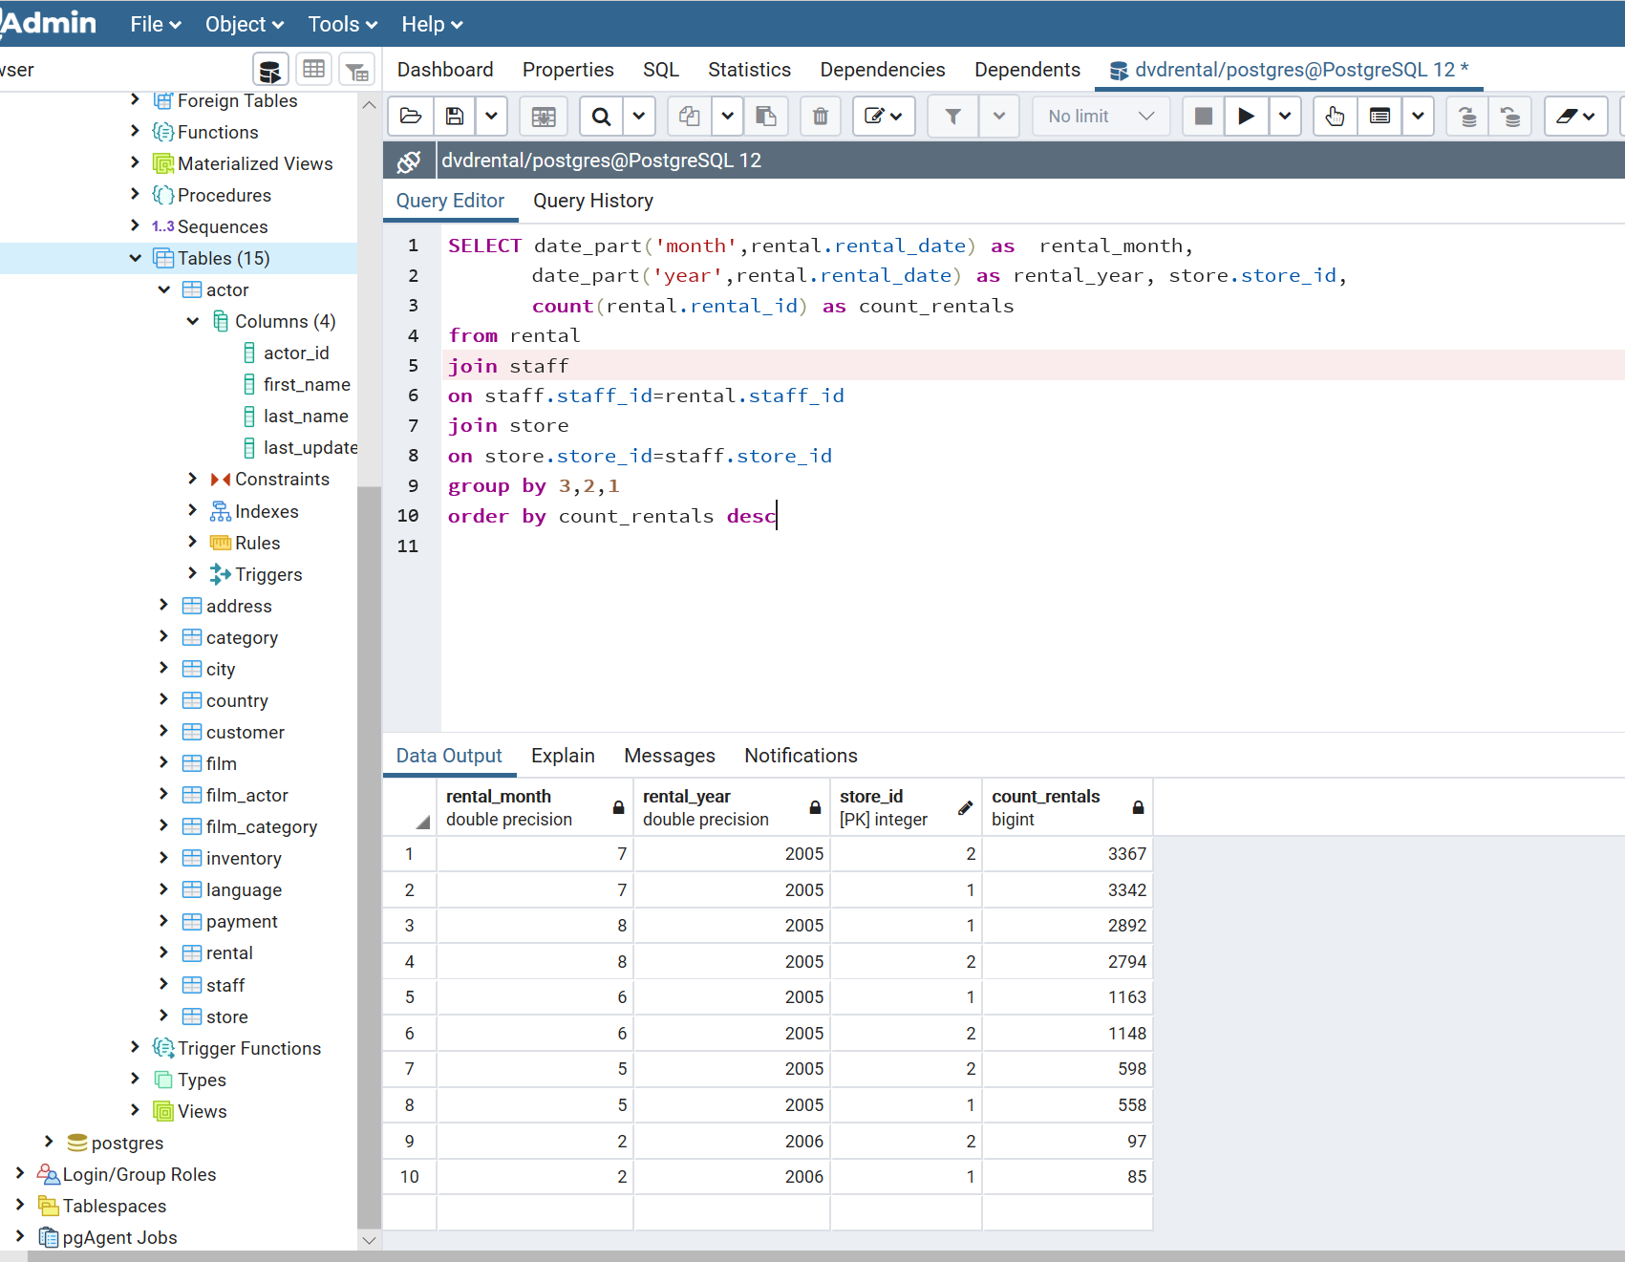
Question 4: Compare the 2 stores regarding the amount of rental orders during every month for all the years there is data for

